Slide 1
Interfaces
Prepared By
Sophia Ajaz

Slide 2
Interfaces
What is an interface?
Why is an interface useful?
How do you define an interface?
How do you use an interface?
2

Slide 3
What is an interface? Why is an interface useful?
An interface is a classlike construct that contains only constants and abstract methods. In many ways, an interface is similar to an abstract class, but the intent of an interface is to specify behavior for objects. For example, you can specify that the objects are comparable, edible, cloneable using appropriate interfaces.
3

Slide 4
Define an Interface
To distinguish an interface from a class, Java uses the following syntax to define an interface:
public interface InterfaceName {
constant declarations;
method signatures;
}
Example:
public interface Edible {
/** Describe how to eat */
public abstract String howToEat();
}
4

Slide 5
Interface is a Special Class
An interface is treated like a special class in Java. Each interface is compiled into a separate bytecode file, just like a regular class. Like an abstract class, you cannot create an instance from an interface using the new operator, but in most cases you can use an interface more or less the same way you use an abstract class. For example, you can use an interface as a data type for a variable, as the result of casting, and so on.
5

Slide 6
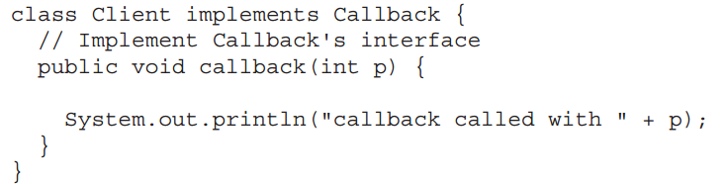
Implementing Interfaces
The type signature of the implementing method must match exactly the type signature specified in the interface definition.

Slide 7
Example
You can now use the Edible interface to specify whether an object is edible. This is accomplished by letting the class for the object implement this interface using the implements keyword. For example, the classes Chicken and Fruit implement the Edible interface (See TestEdible).
Run
Edible
TestEdible
7

Slide 8
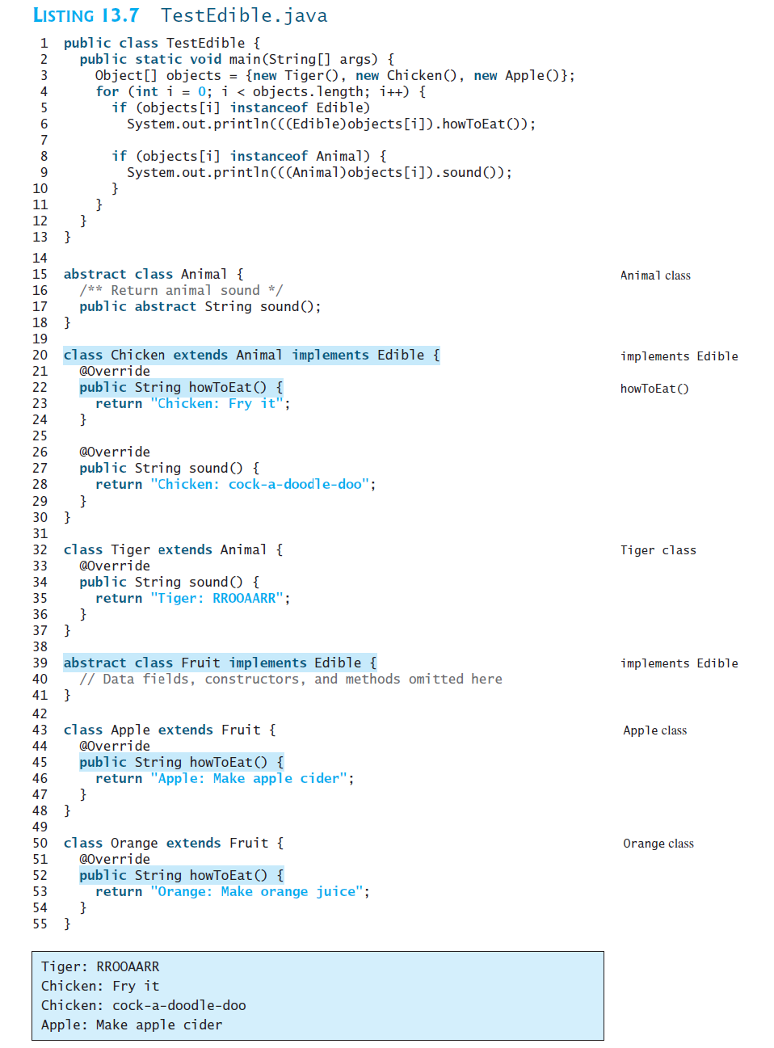

Slide 9
Omitting Modifiers in Interfaces
All data fields are public final static and all methods are public abstract in an interface. For this reason, these modifiers can be omitted, as shown below:
A constant defined in an interface can be accessed using syntax InterfaceName.CONSTANT_NAME (e.g., T1.K).
9

Slide 10
Interfaces vs. Abstract Classes
Abstract Classes | Interfaces
A class can extend only one abstract class | A class can implement any number of interfaces.
In abstract class keyword ‘abstract’ is mandatory to declare a method as an abstract | In an interface keyword ‘abstract’ is optional to declare a method as an abstract
abstract class can have protected and public abstract methods | Interface can have only public abstract methods
No restrictions on variables. | It can have only constant variables
Method that are not declared abstract can have its implementation. | No method can have implementation.
Constructors are invoked by subclasses through constructor chaining. | No constructors
A strong is-a relationship can be modeled using abstract classes. | A weak is-a relationship can be modeled using interfaces.

Slide 11
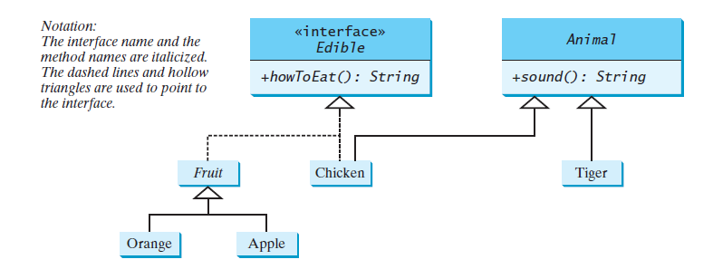
UML Class Diagram Notation

